Slide 1
Customer Churn Prediction Using Big Data
Reporter: Ke Xu
Notes:
Good evening, everyone. I’m excited to present my project, which focuses on a highly impactful and practical topic: Customer Churn Prediction Using Big Data.

Slide 2
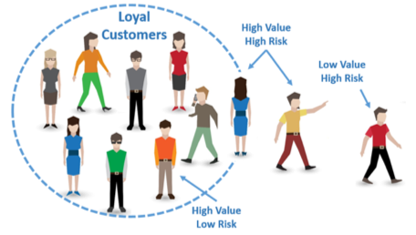
Introduction
Customer churn prediction is a key area of interest for businesses aiming to retain customers and improve long-term profitability.
Churn occurs when customers stop using a service or product, and predicting when it will happen is crucial for businesses to take proactive measures to retain high-value customers.
Notes:
Customer churn — or the loss of clients over time — is a major challenge for subscription-based businesses. Read the slides~~~.

Slide 3
Problem Statement
The primary goal of this project is to predict customer churn (whether a customer will leave the service in the near future). This binary classification problem will involve predicting a target variable where:
1 indicates that the customer will churn. 0 indicates that the customer will not churn.
Given the scale of the dataset and the potential impact of accurate churn predictions, this project will explore a range of algorithms to ensure the best model is selected for the task.
Notes:
At the core of the project is a binary classification task. For each customer, the model predicts a label: 1 if the customer is likely to churn (leave the service), and 0 if the customer is expected to stay. read the slides~~~

Slide 4
Telco Customer Churn Dataset
Source: IBM Sample Datasets (frequently used in Kaggle and ML educational materials)
Format: CSV file
Rows: ~7,000 (each row represents one customer)
Columns: 21 total variables including:
Cusomer demographics
Service subscription details
Account and billing information
Churn label (target variable)
In order to meet the dataset size requirement, I randomly sample from the existing dataset and duplicate records to increase the number of rows to nearly 1,000,000.
Notes:
The core dataset I’m using is the Telco Customer Churn Dataset, which contains about 7,000 records. Read the slides~~~

Slide 5
Data Preprocessing
After loading the dataset, I firstly check for non-numeric values and empty strings in the numerical columns and replace empty strings with NaN.
If there are still missing values after the replacement, impute them with column mean.
Encode target variables and other binary categorical variables.
Initialize the StandardScaler and apply Min-Max scaling to the numerical features
Calculate Z-scores for numerical columns and Identify outliers based on Z-score (|Z| > 3). Using IQR (Q3-Q1) to remove outliers (values outside 1.5 * IQR).
Notes:
So now let’s begin our journey. Firstly about data preprocessing, read the slides~~~.

Slide 6
Feature Analysis
Numerical Features:
Customer tenure: The length of time the customer has been using the service.
Monthly Charges: The average amount spent per month by the customer.
Total Charges: The total charges of a customer over time.
Categorical Features:
Gender, SeniorCitizen, Partner, Dependents, PhoneService, MultipleLines, InternetService, OnlineSecurity, OnlineBackup, DeviceProtection, TechSupport, StreamingTV, StreamingMovies, Contract, PaperlessBilling, PaymentMethod,
Target Variable: Churn
Notes:
As for feature analysis, the major features I used are, read slides~~~

Slide 7
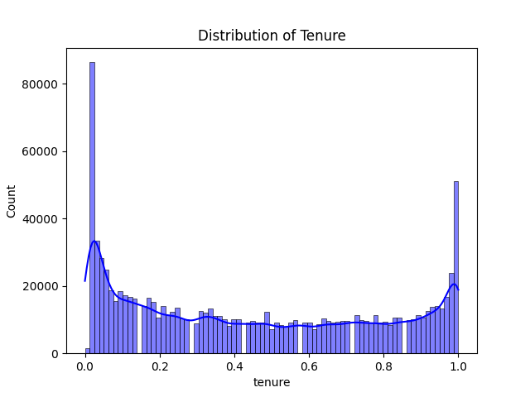
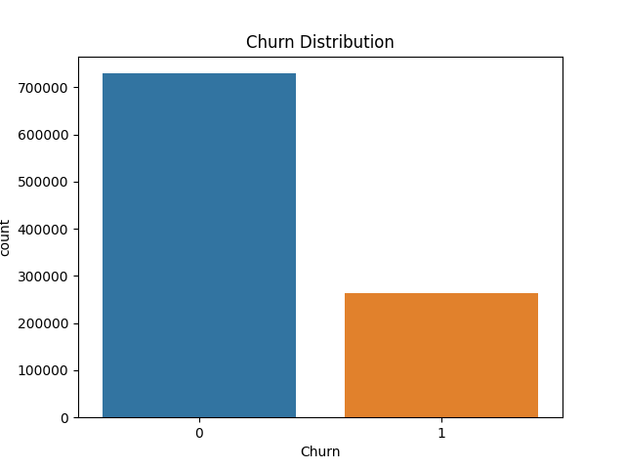
Feature Analysis
Notes:
This plot displays the distribution of the tenure feature, normalized between 0 and 1. It indicates two large customer segments: One that just joined the service (low tenure). Another that has been with the company for a long time (high tenure). The middle range (0.3 to 0.7) has relatively fewer customers. The spike near tenure = 1 suggests strong loyalty or survivorship bias among long-term users. These customers might be satisfied or locked into favorable contracts or bundles. The plot on the right visualizes the Churn Distribution. As we can see it is an Imbalanced Dataset with Roughly 73% of customers stayed, while About 27% of customers churned. To cope with this, I used SMOTE to oversample minority class and focus on recall, F1-score, and ROC-AUC to evaluate the model.

Slide 8
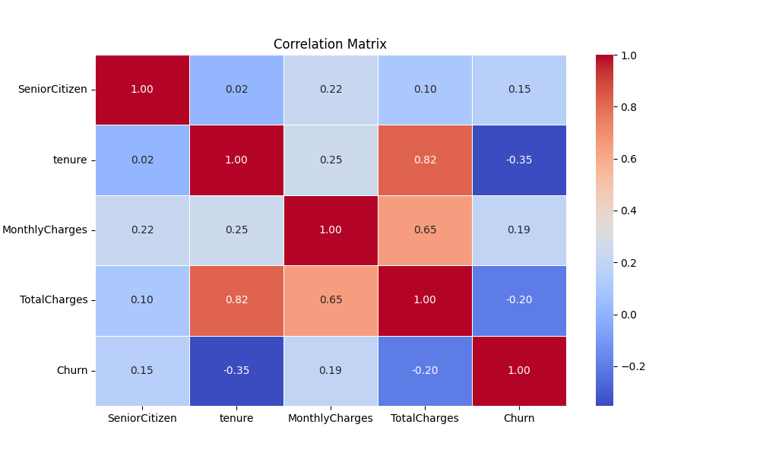
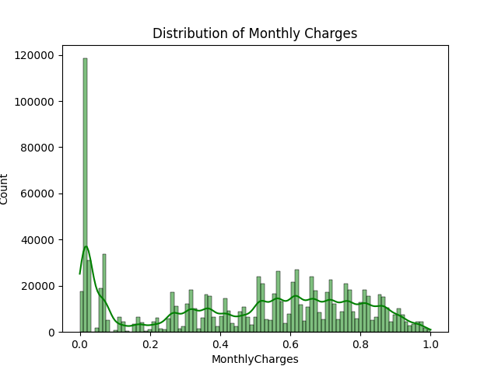
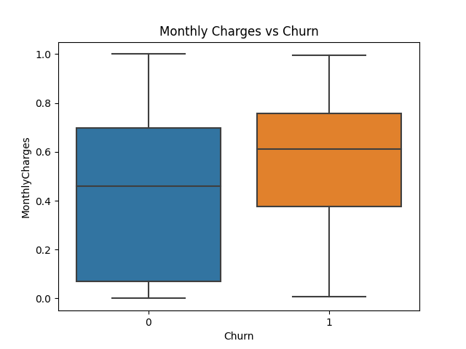
Feature Analysis
Notes:
For numerical features, this plot shows the distribution of the MonthlyCharges feature, normalized between 0 and 1. There is a large spike near 0, suggesting a high concentration of customers with very low monthly charges. The middle section is relatively flat, suggesting a diverse range of customers with standard pricing structures. There is a Light Tail at Higher Charges suggesting fewer customers are paying close to the maximum monthly rate. The box plot shows the relationship between Monthly Charges and Churn. The median monthly charge for churned customers (Churn = 1) is clearly higher than that for non-churned customers. This suggests that customers paying more each month are more likely to churn. Churned customers have a tighter interquartile range (IQR) centered around mid-to-high charge levels. Non-churned customers show a wider spread, with more individuals paying low amounts. Both groups have similar upper whiskers, but churners tend to cluster around higher charges, whereas non-churners include many low-paying users. About feature correlation matrix, There is Moderate negative correlation between tenure and Churn — customers with longer tenure are less likely to churn. This is one of the strongest predictors of churn. And also a Weak negative correlation between TotalCharges and Churn— higher total payments over time are associated with lower churn. These may be more invested/loyal customers. As for MonthlyCharges and SeniorCitizen with Churn, their Weak positive correlation indicate customers with higher monthly bills are slightly more likely to churn and vice versa.

Slide 9
Model Selection and Hyperparameter Tuning
I select three basic machine learning algorithm to apply to the churn prediction problem:
Logistic Regression: A simple but interpretable model for binary classification, serving as a baseline model.
Random Forest: An ensemble of decision trees that reduces overfitting and improves generalization.
Gradient Boosting Machines (GBM): A powerful ensemble method, such as XGBoost, that works well for structured data.
For each algorithm, I perform hyperparameter tuning using techniques like Grid Search or Randomized Search to optimize model performance. Key hyperparameters to tune include:
Logistic Regression: Regularization strength (C), solver type.
Random Forest: Number of estimators, maximum depth of trees.
GBM: Learning rate, number of estimators, maximum depth.
Notes:
After analyze those unique features, I am ready to find the best-performing model. Read the slides ~~~

Slide 10
Model Evaluation Metrics
I use the following performance metrics to evaluate the models:
Accuracy: The proportion of correct predictions (suitable for balanced datasets).
Precision: The proportion of true positive predictions out of all positive predictions.
Recall: The proportion of true positive predictions out of all actual positives (important for identifying churn).
F1-Score: The harmonic mean of precision and recall, useful for imbalanced datasets.
Area Under the ROC Curve (AUC-ROC): Evaluates the model's ability to distinguish between classes.
Notes:
Model evaluation will be based on accuracy, precision, recall, F1-score, and ROC-AUC.

Slide 11
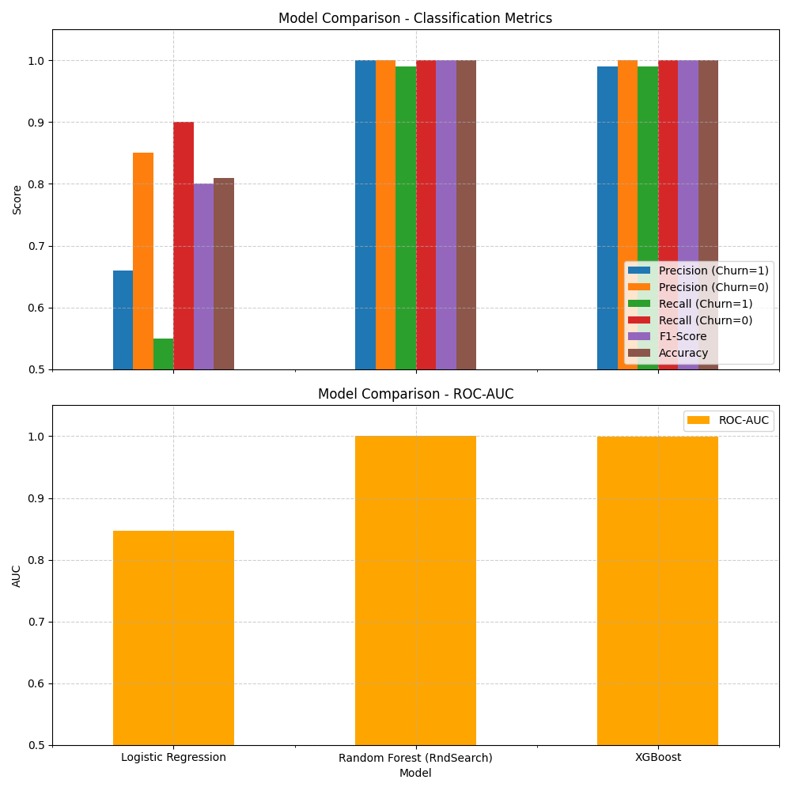
Model Comparison
Notes:
For Random Forest and XGBoost: Achieve near-perfect scores on all classification metrics, Suggests that these models capture both classes extremely well, including correctly identifying customers who are likely to churn. However, such perfect scores may indicate Overfitting on a possibly duplicated or synthetic dataset. And for Logistic Regression it performs reasonably but clearly worse across the board. Precision ≈ 0.66, Recall ≈ 0.55 → meaning it misses nearly half of actual churners. Accuracy and F1-score are also lower, which is expected for a simpler model. ROC-AUC reflects how well the model separates churners from non-churners, regardless of threshold. Random Forest and XGBoost exhibit near-perfect separability, again raising overfitting concerns. Logistic Regression, while not perfect, gives a realistic ROC-AUC for real-world applications. So maybe in the feature, I will use Cross-validation or other techniques to Validate these high-performing models.

Slide 12
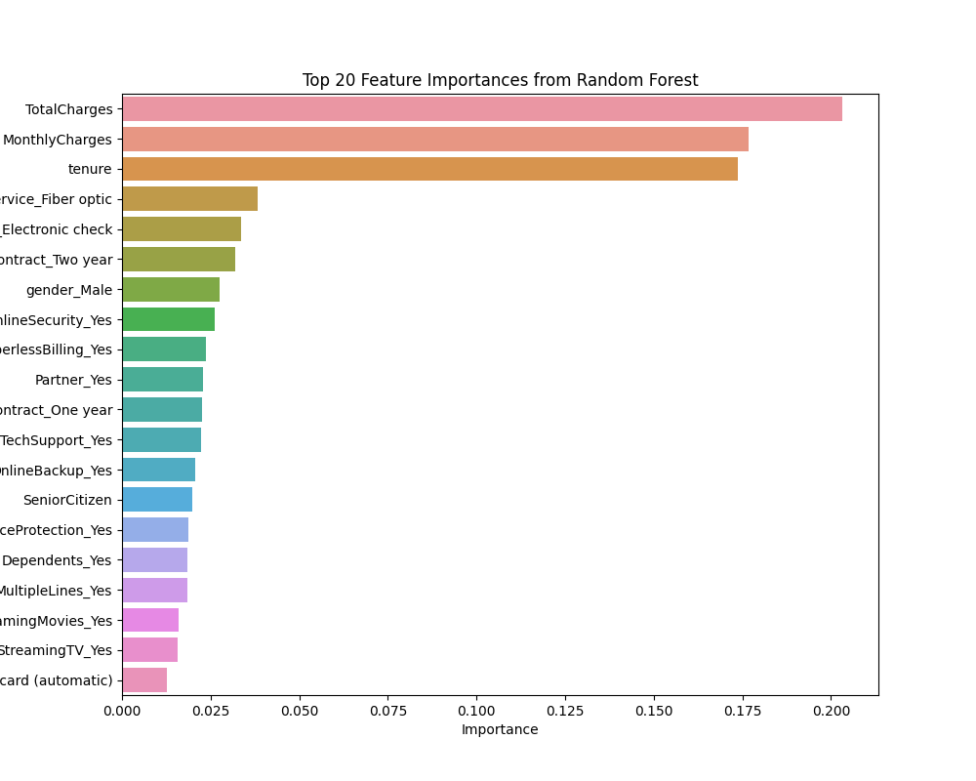
Feature Importance Analysis
Notes:
Last but not least, let’s make a Feature Importance Analysis. The plot shows the Top 20 Feature Importances from a Random Forest model. Feature importance reflects how useful each variable is in reducing impurity across all trees in the forest. As we can see, the top features are TotalCharges, MonthlyCharges, tenure. These top three are strongly predictive, aligning well with prior analysis: Customers with low tenure and high monthly charges tend to churn more. TotalCharges captures both engagement duration and value contribution. I conclude that retention strategies should prioritize new customers with high monthly charges and those using electronic check payments. Encouraging longer-term contracts and promoting value-added services, such as technical support, can help reduce churn. Additionally, key features like tenure, monthly charges, and contract type should be used for customer segmentation and developing early warning systems.

Slide 13
Conclusion
This project aims to create a robust, scalable model for predicting customer churn using big data techniques. By generating synthetic data and applying machine learning algorithms, businesses can make informed decisions about customer retention, ultimately improving profitability and customer satisfaction. The process will involve careful data preprocessing, algorithm selection, model tuning, and evaluation to ensure the best results, with actionable insights that businesses can apply in their customer relationship management strategies.

Slide 14
THANKS!
Any questions?

